Slide 1
INI3111
Test Preparation
Files 4, 5, and 6

Slide 2
Vocabulary 4A: The Family
My niece is a very beautiful girl
Grammar 4A:
Possessive [ ‘s ]
My wife’s mother is terrible!

Slide 3
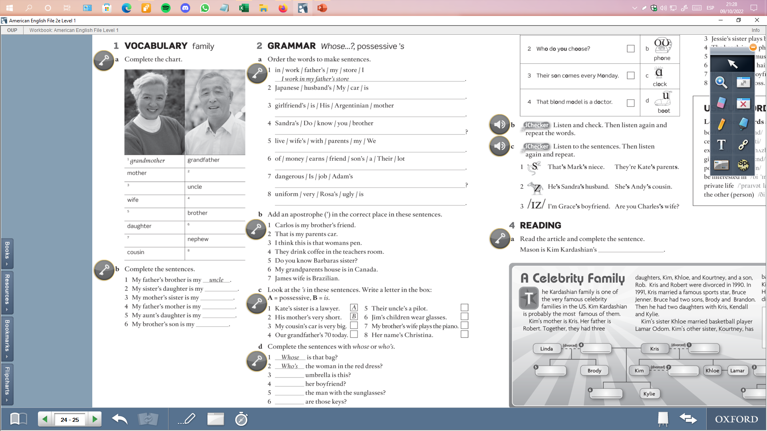
My husband’s car is Japanese
His girlfriend’s mother is Argentinian
Do you know Sandra’s brother ?
We live with my wife’s parents
Their son’s friend earns a lot of money
Is Adam’s job dangerous ?
Rosa’s uniform is ugly
father
aunt
‘
husband
‘
sister
‘
‘
son
‘
‘
niece
cousin
B
A
A
A
B
B
niece
aunt
grandmother
Whose
cousin
Who’s
nephew
Who’s
Whose

Slide 4
Vocabulary 4B: Everyday activities
I usually go to bed at 11:30 pm
Grammar 4B:
Prepositions [ at, in, on, to ]
We have English class on Mondays and Wednesdays

Slide 5
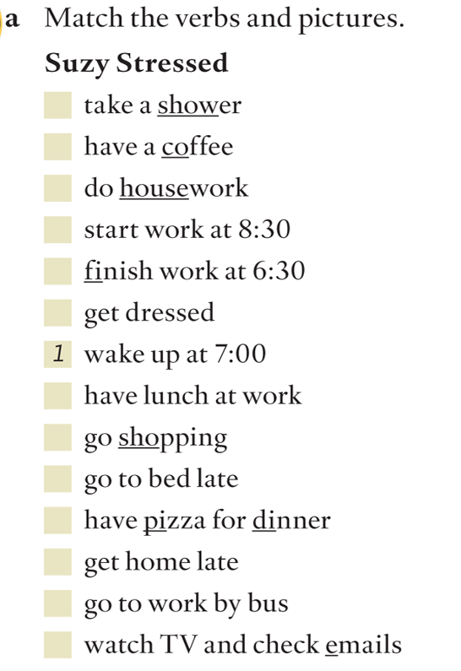
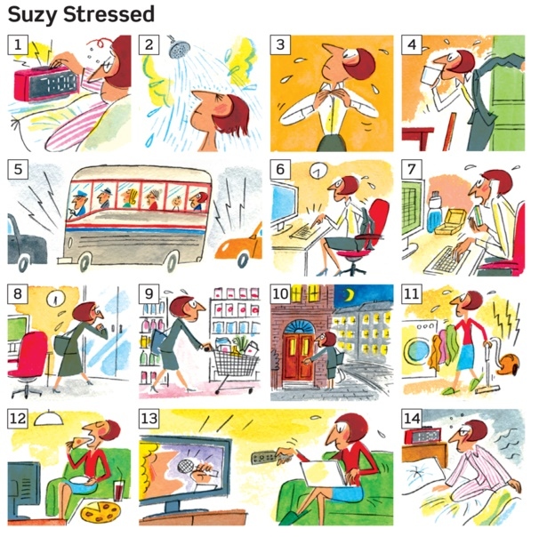
2
4
11
6
8
3
7
9
14
12
10
5
13

Slide 6
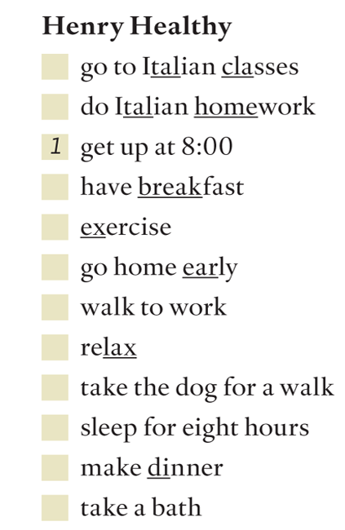
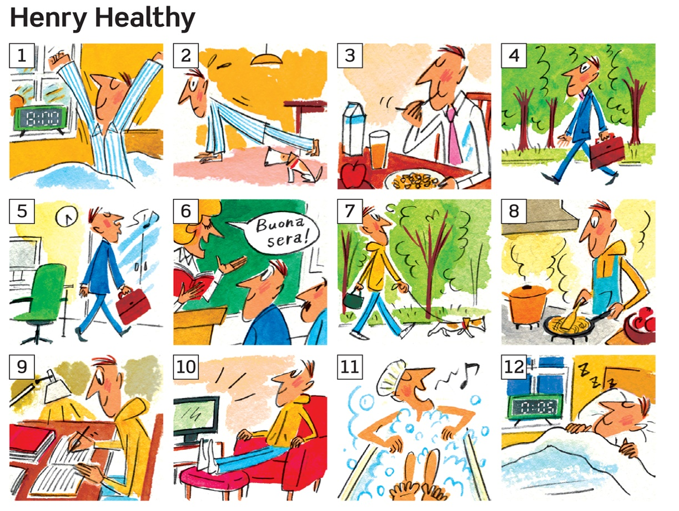
6
9
3
2
5
4
10
7
12
8
11

Slide 7
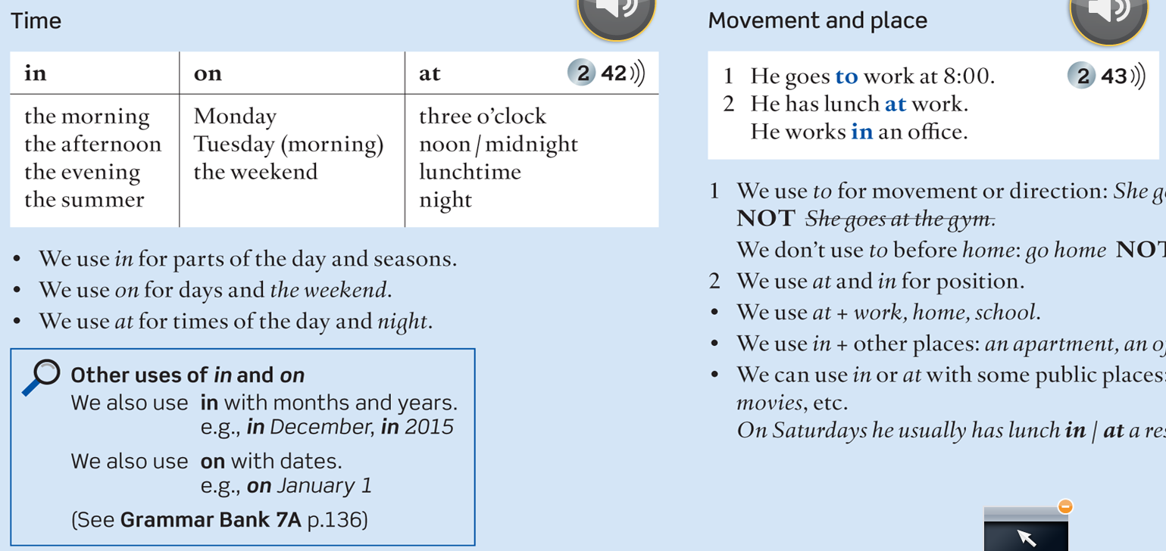
TIME:
I always have English class in the evening
PLACE:
I study English at Duoc UC

Slide 8
Vocabulary 4C: Adverbs of frequency / Expressions of frequency
Always – Usually – Often – Sometimes – Hardly ever – Never / once a week – every summer, etc
Grammar 4C:
Adverbs of frequency / Expressions of frequency
Do you usually go to work by bus? / we have English class twice a week

Slide 9
Adverbs of Frequency / Expressions of Frequency
Every
Day
Week
Month
year
(1) Once a week
(2) Twice a year
Three times a day
Four times an hour
100% Always
90% Usually
70% Often
50% Sometimes
10% Hardly ever
0% never

Slide 10
Vocabulary 5A: Verbs phrases
Forget – Find – Remember – Use – etc…
Grammar 5A:
Can / Can’t
I can draw very well, but I can’t sing

Slide 11
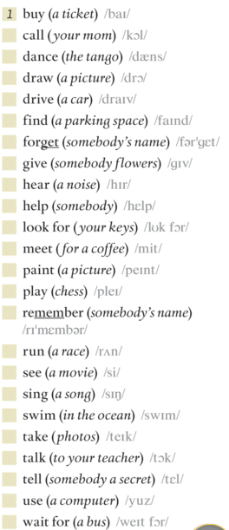

Vocabulary 1
Comprar
Llamar
Bailar
Dibujar
Conducir
Encontrar
Olvidar
Dar
Oir
Ayudar
Buscar
Conocer/juntarse
Pintar
Jugar / tocar un instrumento
Recordar
Correr
Ver
Cantar
Nadar
Tomar (fotos)
Conversar
Contar (a alguien un secreto)
Usar
esperar
ABILITIES/SKILLS
A: Can you drive a car?
B: Yes, I can drive very well. I can drive a car, but I can’t drive a truck
I can’t remember where I saved the photo

Slide 12
Vocabulary 5B: Verbs
Argue – Have a party – Play the drums – Bark – Shout
Grammar 5B:
Present Continuous
The baby next door is crying

Slide 13
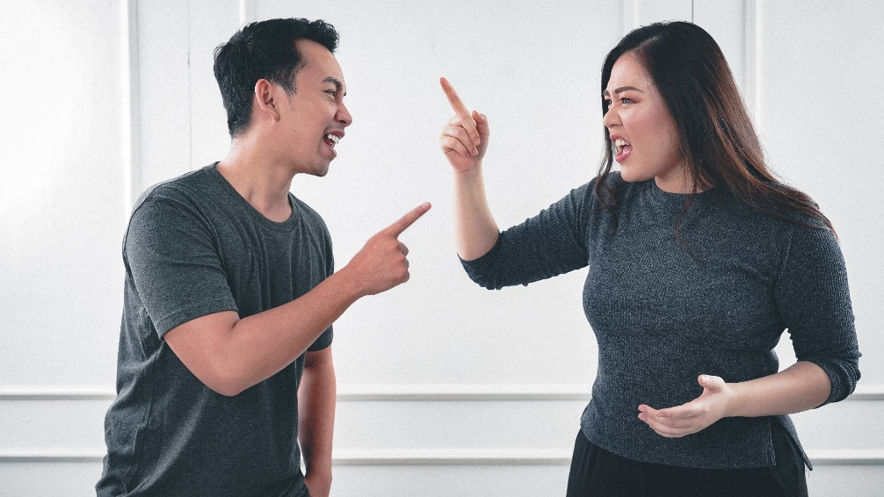
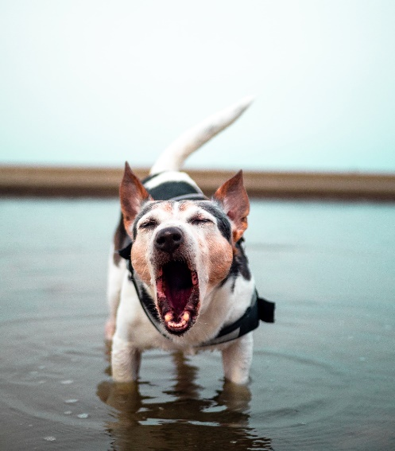
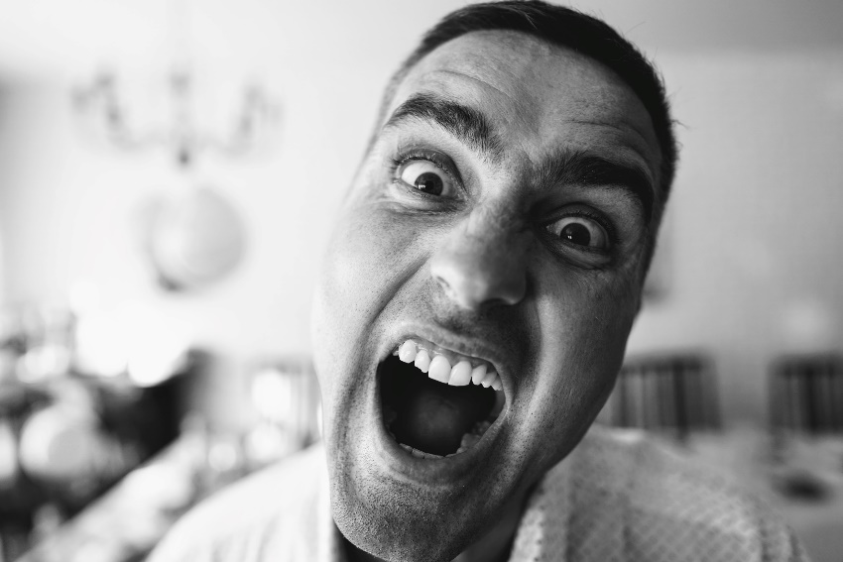
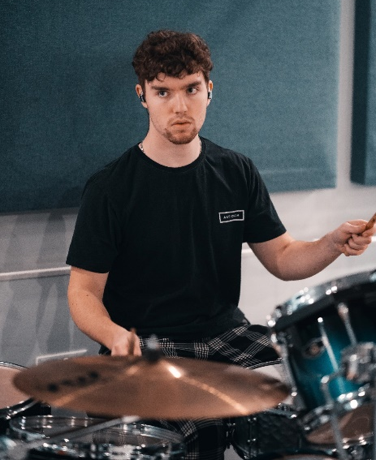
5B: What are they doing? (Present Continuous)
1
2
3
4
Verbs:
Play
Argue
Shout
Bark
1 – They are arguing

Slide 14
Vocabulary 5C: Verbs / Dates / Weather / Seasons
Shine – Rain – Snow / May 25th / Foggy – Cloudy – Windy – Warm / Summer – Fall – Winter - Spring
Grammar 5C:
Simple Present vs. Present Continuous
I walk to work every day, but today I’m taking the bus because it’s raining.

Slide 15
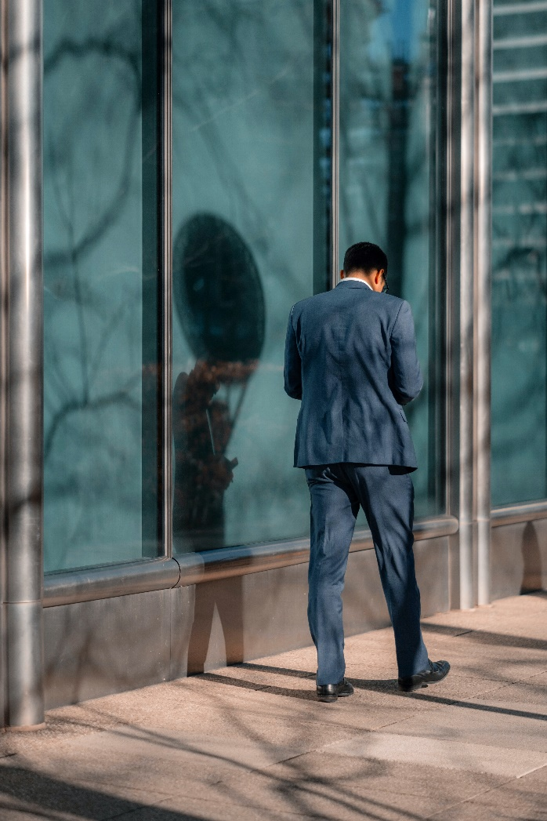
Simple Present Vs Present Continuous
This is Bastian. He is a waiter and he works in a restaurant. He usually drives to work, but today he is walking because his car is broken. He always wears jeans and a t-shirt, but today he is wearing a suit because he is having a meeting. Right now he is arguing with his boss on WhatsApp. They have a good relationship, but today his boss is angry because Bastian is arriving late.
Simple Present:
HABITS/FREQUENCY
Present Continuous:
Now / Right Now / Today

Slide 16
Vocabulary 6A: Object Pronouns
me – you – him – her – it – us – you - them
Grammar 6A:
Object Pronouns
Ana loves Carlos, but he doesn’t like her. She calls him every day, but he doesn’t want to talk to her

Slide 17
Subject Pronouns and Object pronouns
I
YOU
HE SHE IT
WE YOU THEY
ME
YOU
HIM
HER
IT
US
YOU
THEM
I like Lupita Nyong'o in that movie
I like her in that movie
Pamela never talks about Carlos
She never talks about him
Pablo invited his friends to the party
He invited them to the party

Slide 18
Vocabulary 6B: Preference Verbs
Love – like – don’t mind – don’t like - hate
Grammar 6A:
Activities + ING
I like playing videogames very late at night, and I don’t mind getting up early the next day

Slide 19
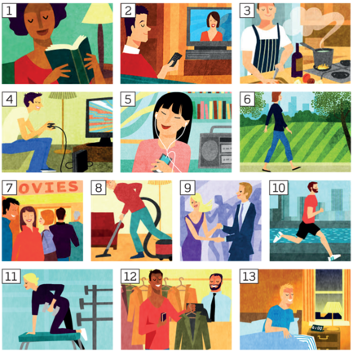
Practice: Do you like…ing?
Preference Verbs
A: Do you like reading?
B: I don’t mind reading for university, but I prefer reading articles about technology

